Slide 1
Quote of the day:
“I went to the store for eight Sprites, but I got home and realized that I picked seven up instead…”

Slide 2
Remembering 9/11

Slide 3
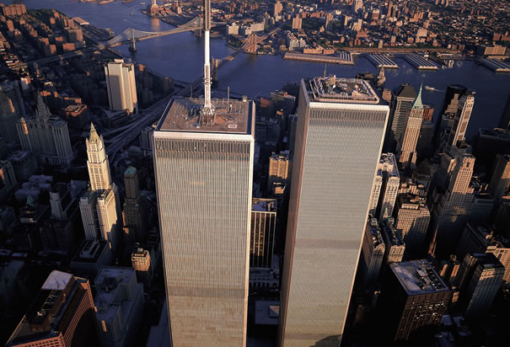
September 11, 2001
Downtown Manhattan, New York City

Slide 4
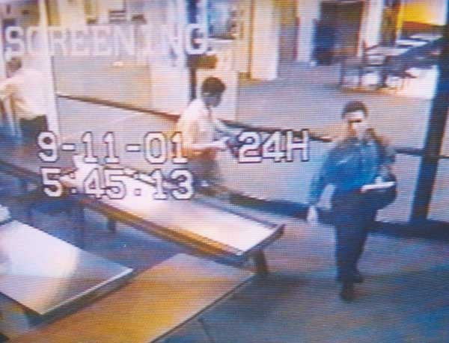
5:45 AM

Slide 5
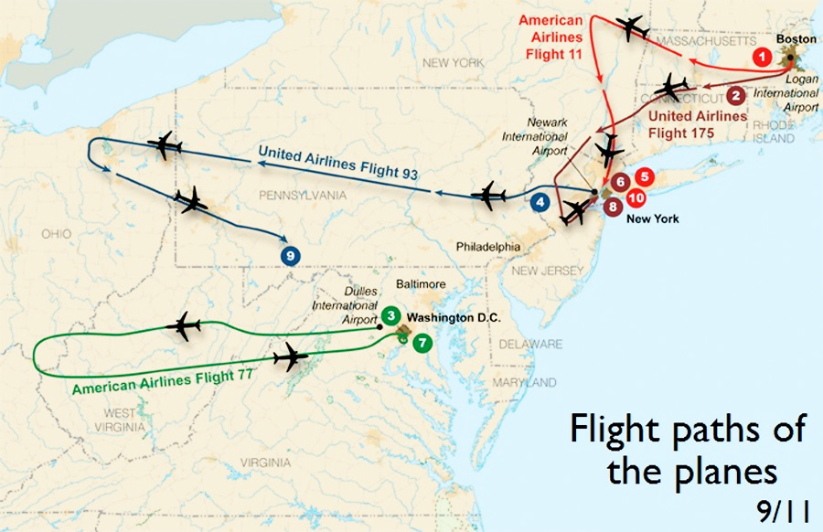

Slide 6
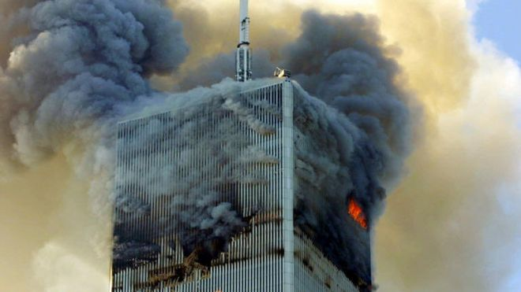
8:45 AM

Slide 8
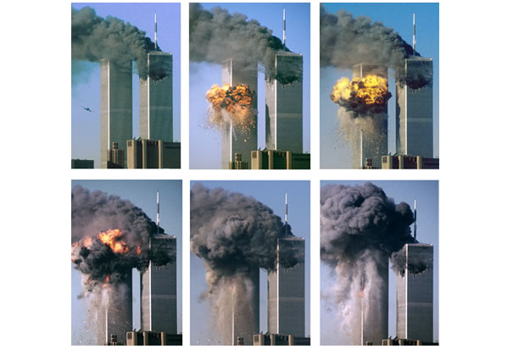
9:03 AM

Slide 9
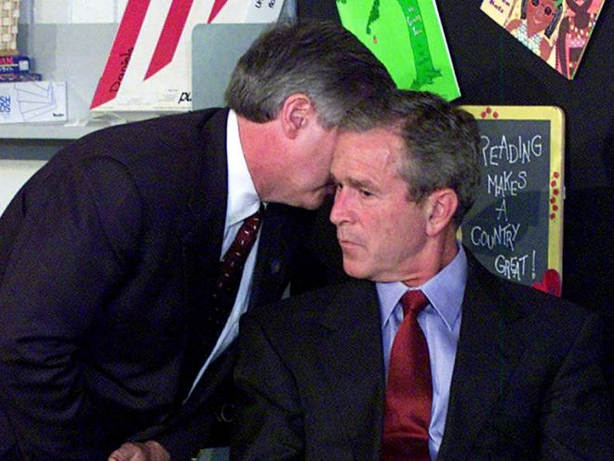
9:05 AM

Slide 10
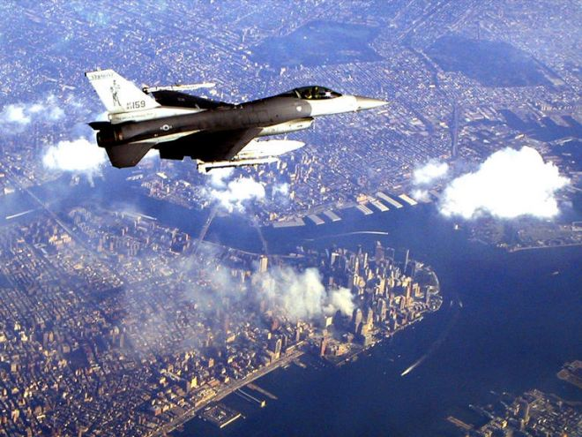
9:13 AM

Slide 11
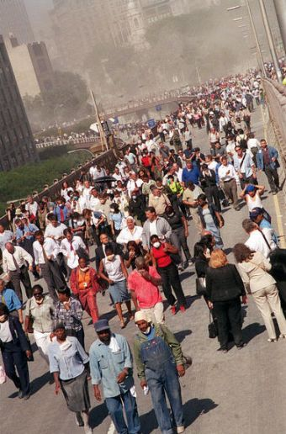
9:21 AM

Slide 12
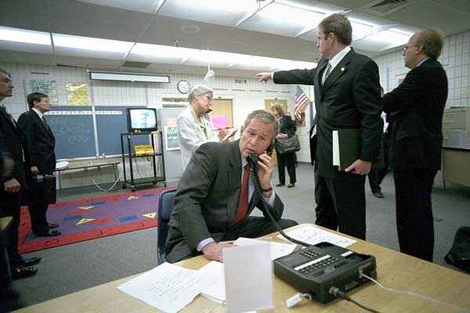
9:31 AM

Slide 13
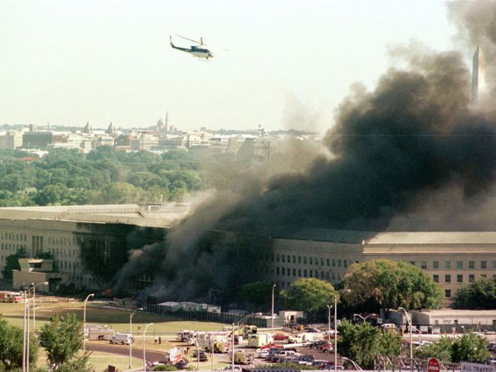
9:40 AM

Slide 14
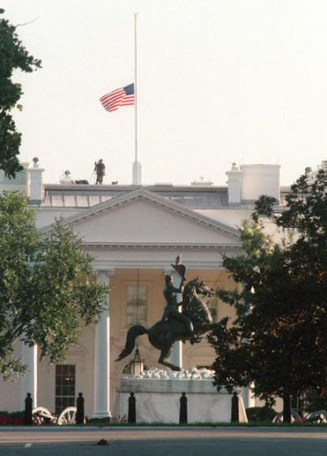
9:43 AM

Slide 15
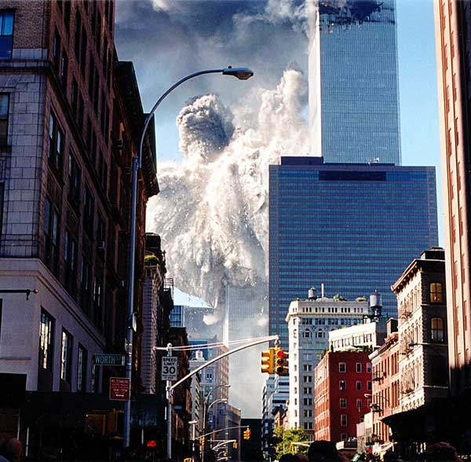
9:59 AM

Slide 16
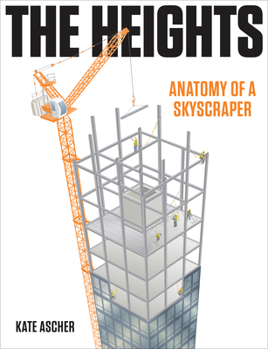

Slide 17
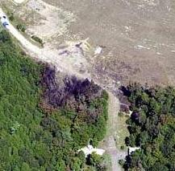
10:03 AM

Slide 18
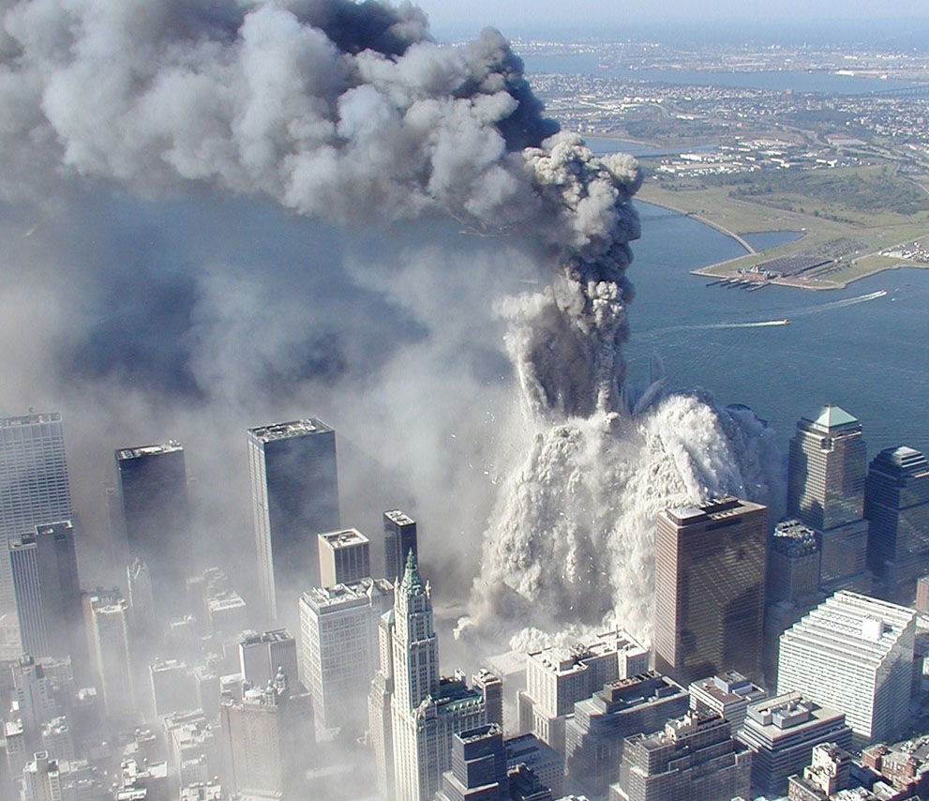
10:28 AM

Slide 19
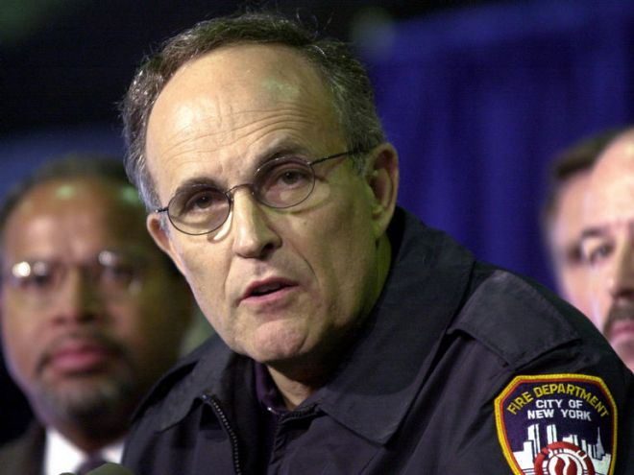
10:49 AM

Slide 20
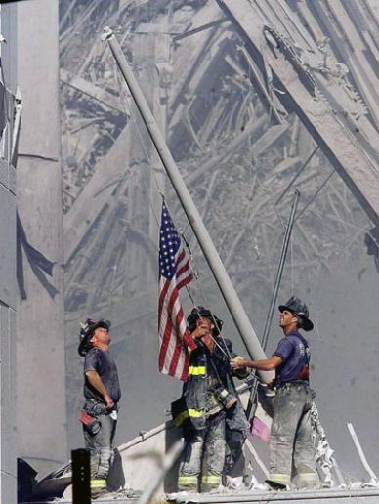
5:00 PM

Slide 21
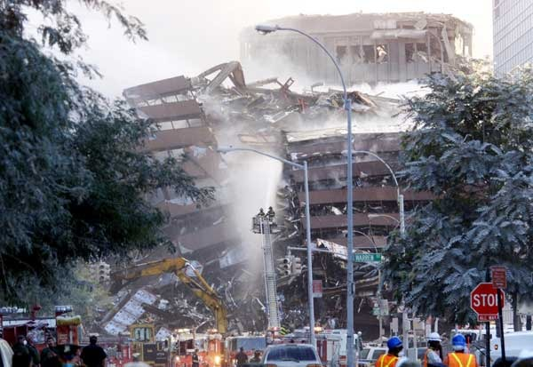
5:20 PM

Slide 22
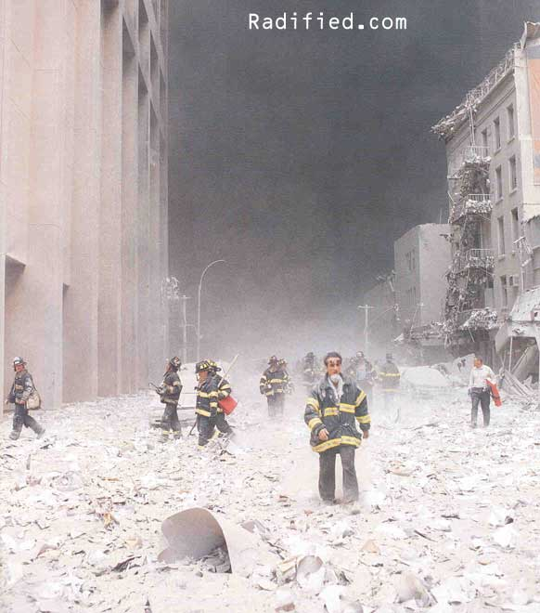
The Aftermath…

Slide 23
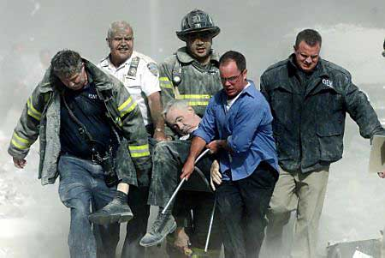

Slide 24
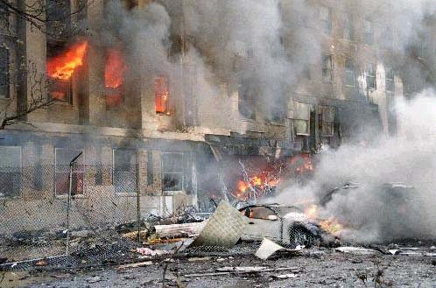

Slide 25
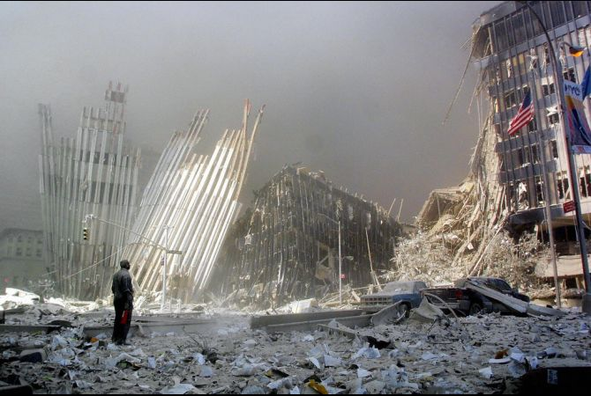

Slide 26
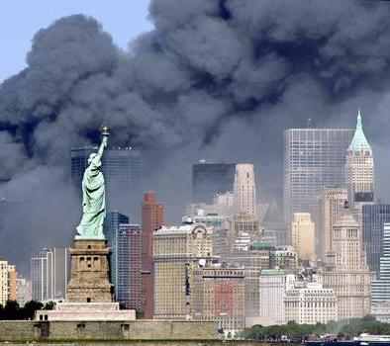

Slide 27
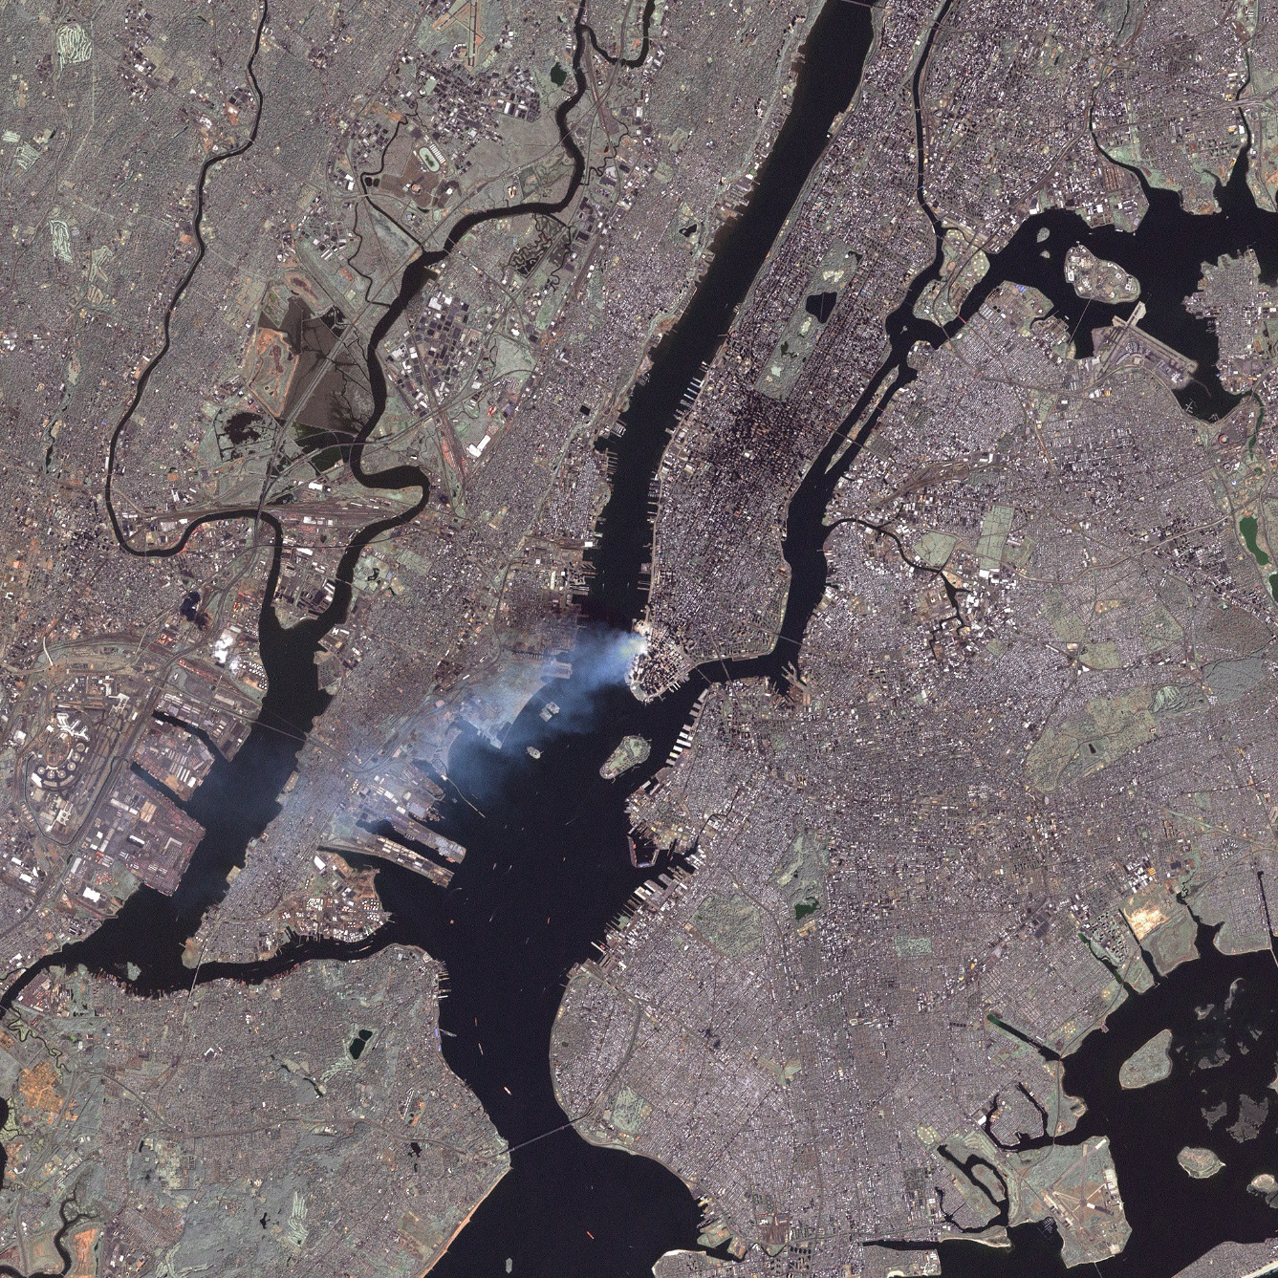
View from space…

Slide 28
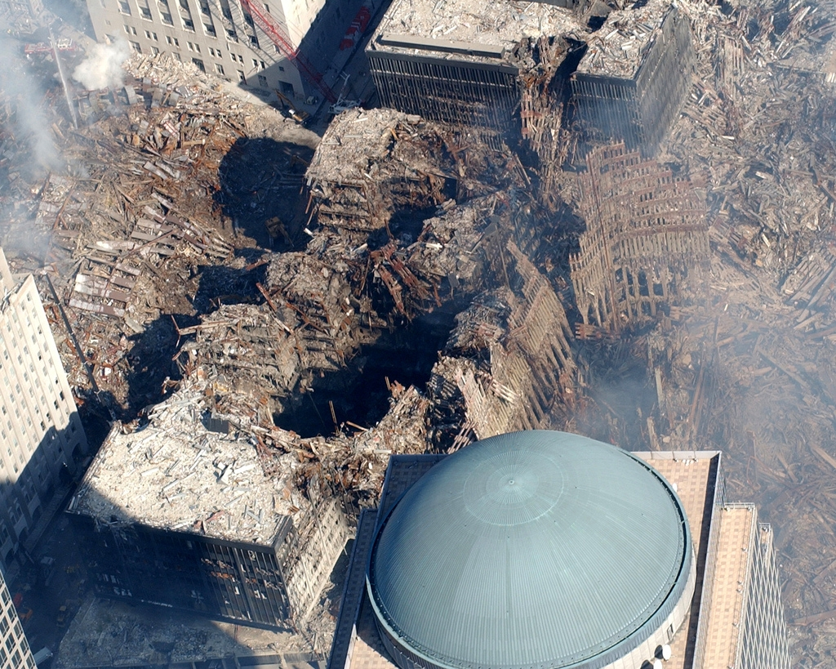

Slide 29
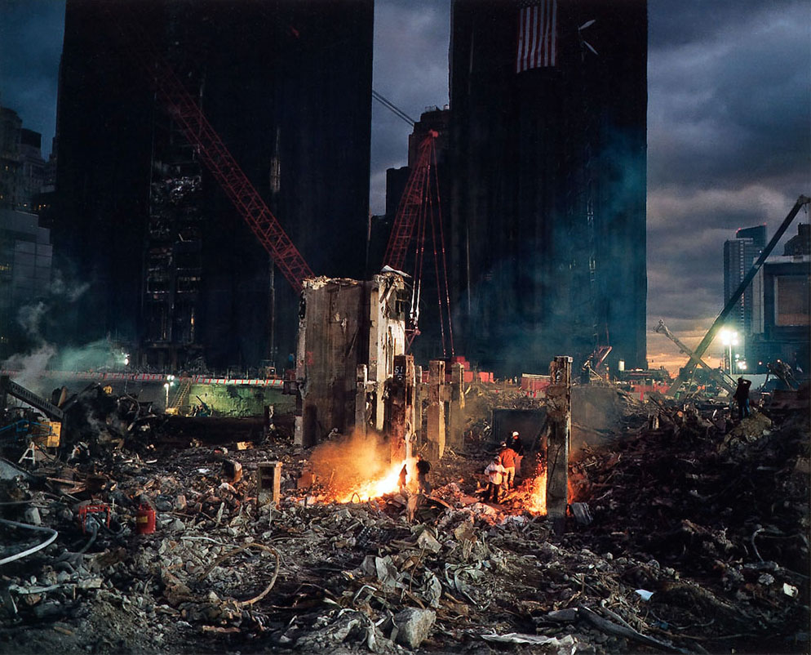

Slide 30
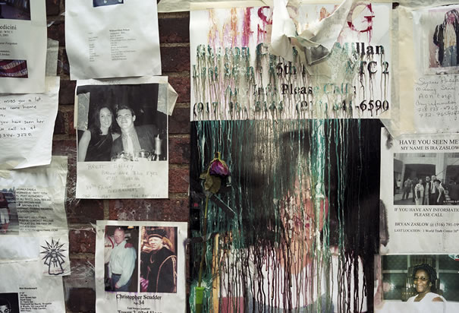

Slide 31
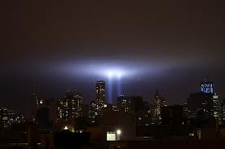
September 11, 2011

Slide 32
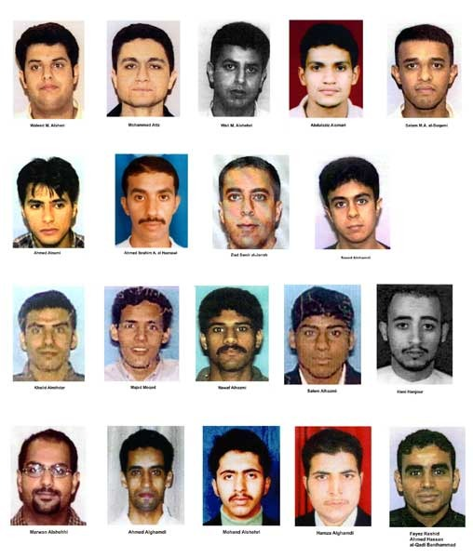
The Accused 9/11 Terrorists

Slide 33
The Damage…
2996 lives lost (including 411 police and firefighters)
13 buildings destroyed or severely damaged (including both of the 110-floor World Trade Center towers)
Tens of thousands of stranded travelers (after all airspace was closed worldwide)
3000 children lost a parent

Slide 34
Impact on America
Led to wars in both Iraq and Afghanistan
Led to the creation of the Department of Homeland Security
Resulted in the largest one-week stock market crash in history and the loss of many billions of dollars in wages
Long-term health problems resulted from all of the toxic debris from the building
Racism towards Middle Eastern peoples

Slide 35
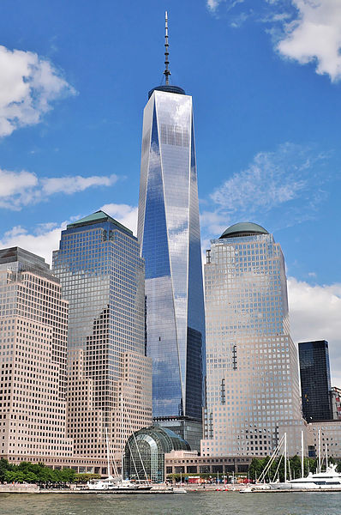
As of September, 2013

